Slide 1
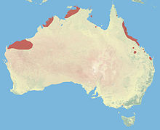
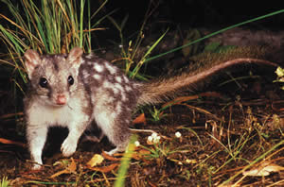
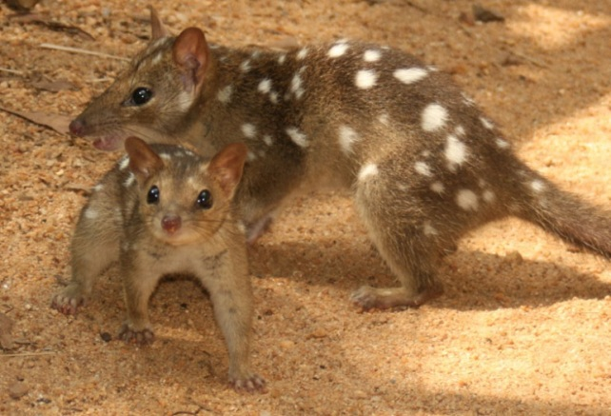
Northern Quoll
The Northern Quoll is a medium-sized carnivorous marsupial.
They are listed as Endangered under the EPBC Act due to pressures from feral animals, cane toads and land clearing.
Interesting Fact: Males die-off completely after mating and leave females to raise the young alone.
Please report any sightings to your
Environmental Advisor on:
EPBC Act: Endangered

